Slide 1

You are at the right place!
We are waiting until everyone joins
Waiting

Slide 2

Data Analysis Small Project with MS Excel

Slide 3

Basic Steps & Interactive Excel Dashboard
Data Cleaning
Saving a copy and Start data cleaning
Changing any data info short to full/ full to short or creating new field, exp. Gender, Age
Changing Text to any format, exp Currency

Slide 4

Basic Steps & Interactive Excel Dashboard
Data Structure
Retailer Dashboard

Slide 5

Basic Steps & Interactive Excel Dashboard
Data Analysis
Data > Data Analysis > Descriptive Statistics
Pivot Table (Example)
Summary of total Sales ( Total Sales, Unit sold, Avg Price per Unit, Operating Profit)
Sales by Brand (Beverage Band vs Total Sales by Years)
Sales By Retailer (Total Sales vs Avg Operating Margin by Quarterly
Sales and Operating Profit Margin by Quarters

Slide 6

Basic Steps & Interactive Excel Dashboard
Data Visualization
Link between Dashboard and Analysis
Insert Chart
Dynamic Dashboard- PivotTable Analyze > Insert Slicers
Sample Data set Link

Slide 7
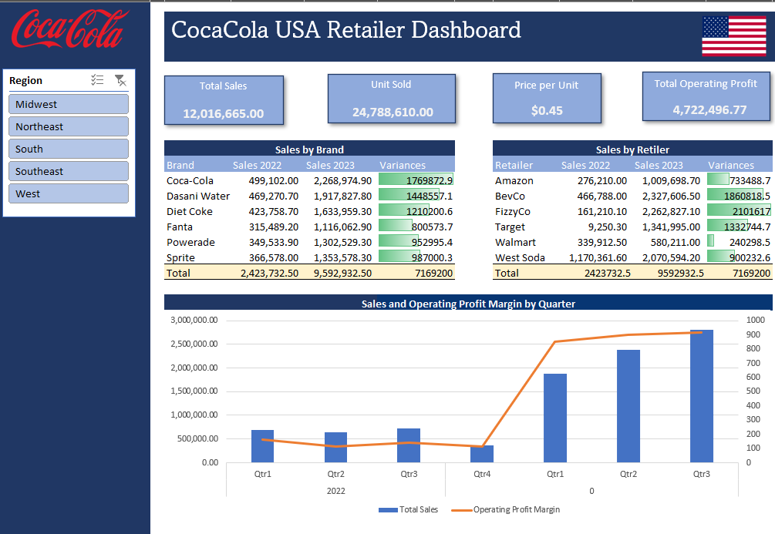
Basic Steps & Interactive Excel Dashboard
Sample Data set Link

Slide 8
Congratulations!
Now you know DA

Slide 9
?

Slide 10
Homework Build the same Dynamic Dashboard Sample Data

